Slide 1
HCI Term Project
201635810 노준영 201635813 박정훈
201635819 신동재 201635840 이정명

Slide 2
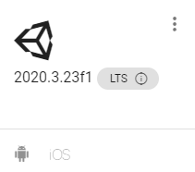
Unity Version
We decide to make AR application with Unity
use 2020.3.23f1(LTS) version
-> most recent version

Slide 3
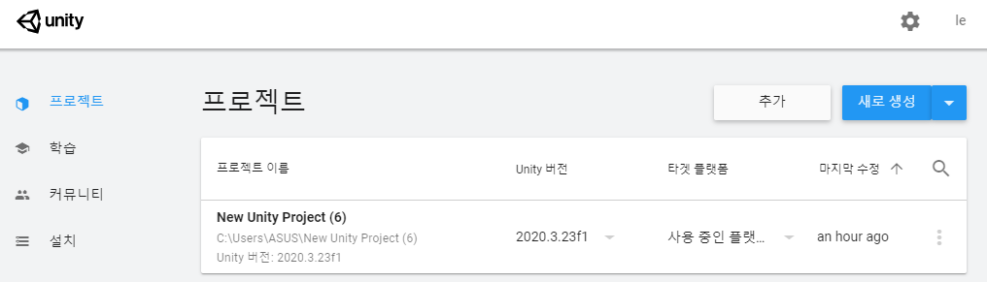
Make project

Slide 4
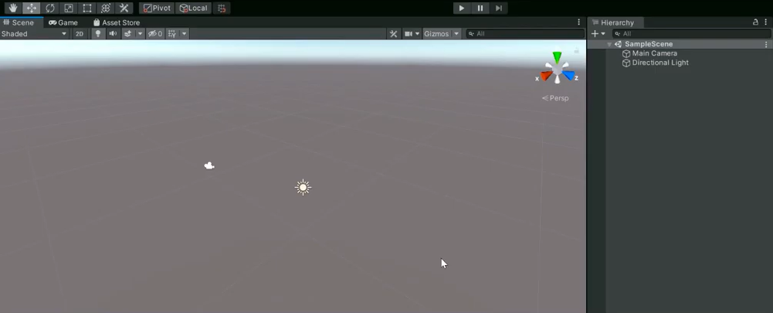
Initial screen

Slide 5
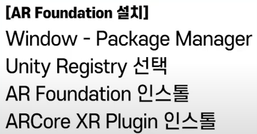
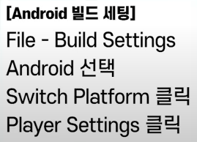
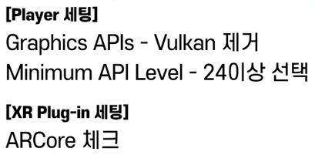
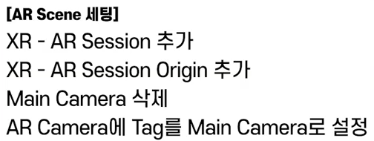
STEP
1
2
3
4

Slide 6
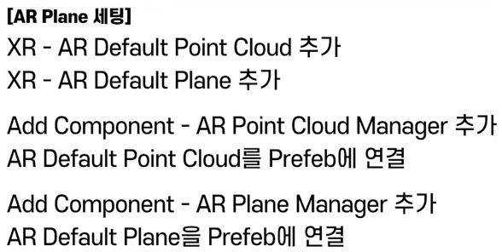
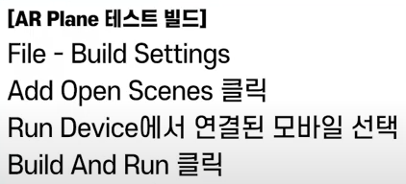
STEP
5
6

Slide 7
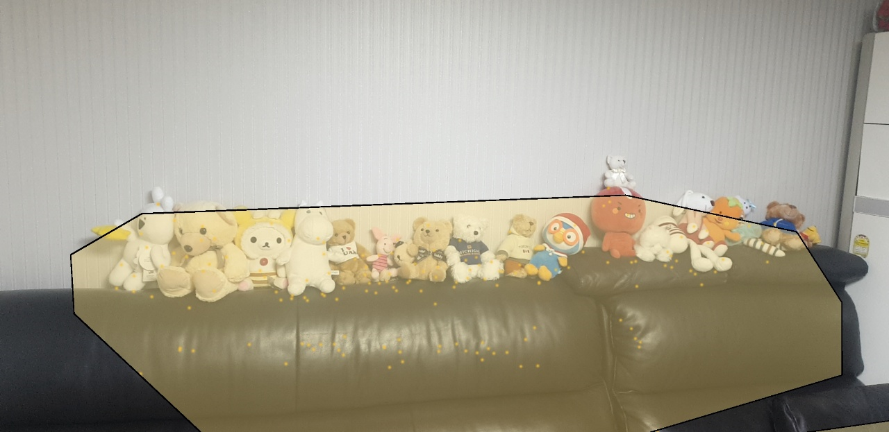
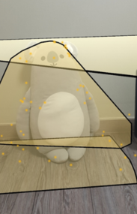
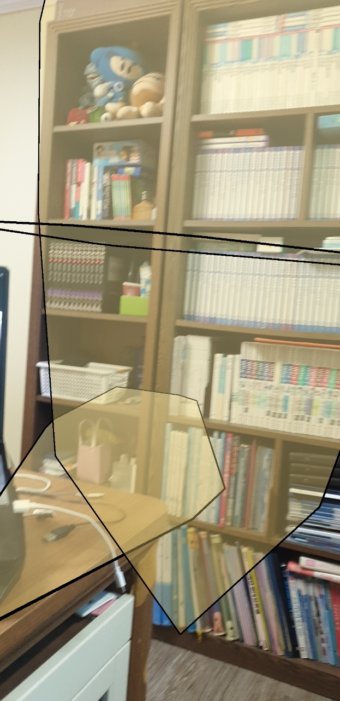
AR test screen
These pictures are screens taken through the AR test of ' Lee Jung Myung' student’s house.
-> This shows the result of recognizing the plane.

Slide 8
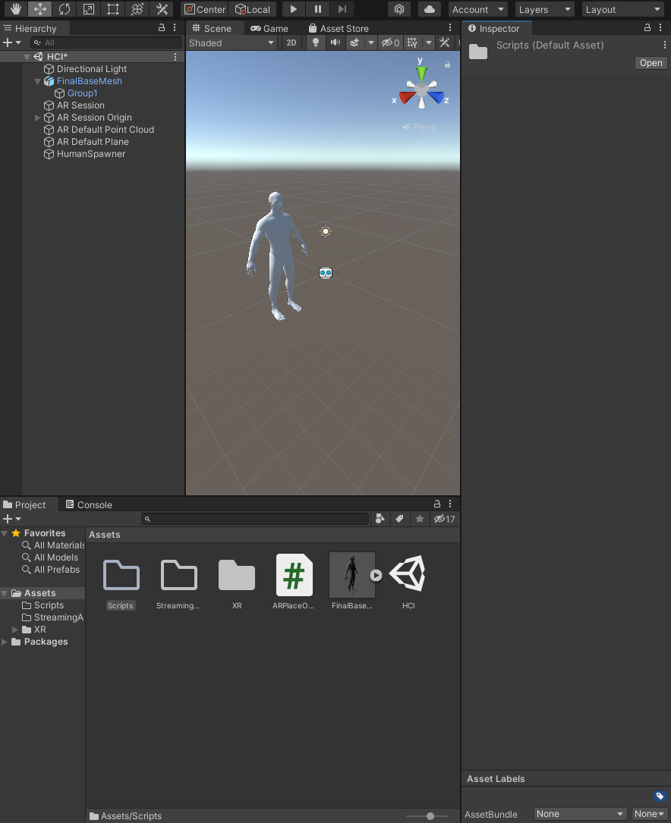
Add 3D model
A 3D model for changing 3D objects has been added.

Slide 9
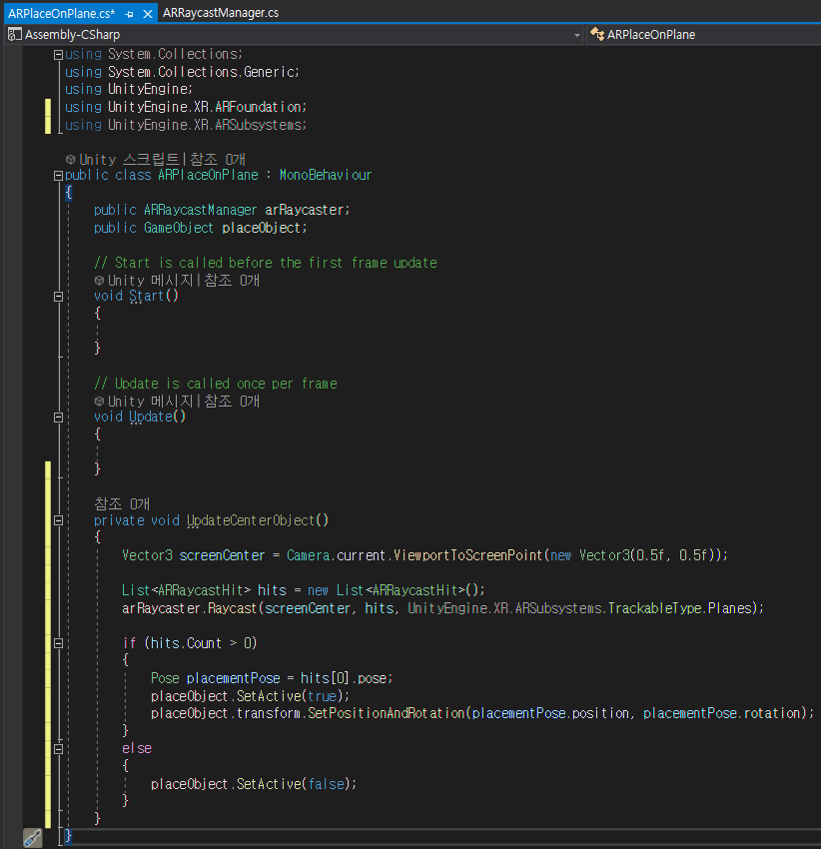
Coding AR Place On Plane
The Plane on the Place was coded through C#.
IF hit -> 3D object show
IF not hit -> 3D object hide

Slide 10
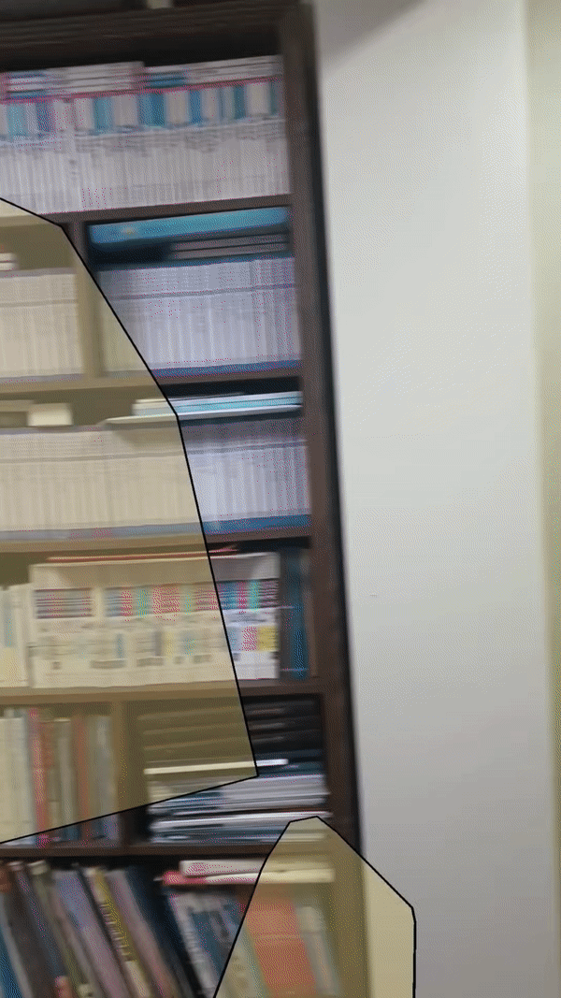
Demo

Slide 11
Reference
https://www.youtube.com/watch?v=gi9iHTY9z1o
https://www.youtube.com/watch?v=ARgf9Q8PLgI

Slide 12
Thank you

